Slide 1
Computer Graphics (L11)
EG678EX
3-D Viewing
Prepared By: Dipesh Gautam

Slide 2
Some Background Concepts
Prepared By: Dipesh Gautam

Slide 3
3-D Object Representation
Many kinds of objects in graphics scene. E.g. flowers, trees, clouds, rocks, bricks, marble, steel etc
All characteristics can’t be described with single way of representation of objects
Two broad categories to represent Euclidean (geometric) solid objects:
  Boundary Representation (B-reps)→ object is assumed as set of surfaces that separate object from surroundings. E.g. surface polygons
  Space-Partitioning Representations→ represented by set of non overlapping contiguous solids. E.g. Octree representation (with cubes)
Natural objects (Non-Euclidean i.e. non-geometrical shape) → Represented by Fractal Geometry.
Prepared By: Dipesh Gautam

Slide 4
3-D Object Representation
Polygon Surfaces
  Approximate representation 3-D objects by set of surface polygons
    Advantage:- speeds up rendering; since all surfaces are represented with linear equations
  More accurate representation for polyhedron
  Curved surface approximation can be improved with increase in number of polygons
Polygon Tables:- To specify polygon surfaces
  Geometric Tables
    Consist of parameters that specify polygon vertices and spatial orientation of polygons
  Attribute Tables
    Consist of parameters that specify transparency, surface texture, color etc.
Polygon Surface Approximation of Cylinder
Prepared By: Dipesh Gautam

Slide 5
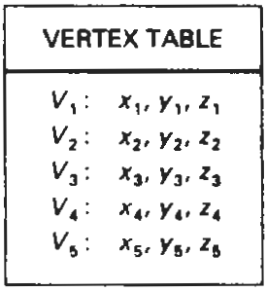
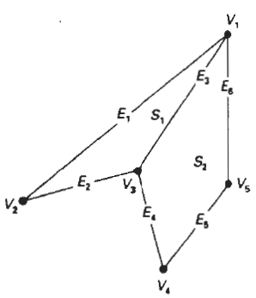
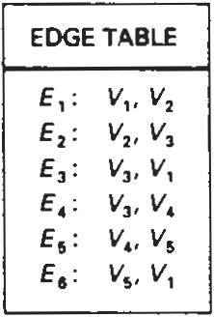
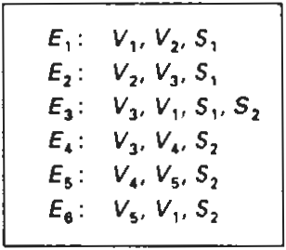
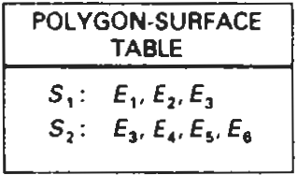
3-D Object Representation
Geometric Tables
  Specified by three lists (each successive tables consists of pointers back to previous table
    Vertex Table
    Edge Table
    Polygon Surface Table
  Only Edge Tables or (Vertex table + Polygon Table) is sufficient ?
    Yes but redundancy (repeated) in drawing
  Alternate representation:- we add extra information for quick identification of redundancy. E.g. as in figure (Alternate Representation), pointers to polygon table are added to edge table so as to notice common edges quickly.
Alternate Representation
Prepared By: Dipesh Gautam

Slide 6

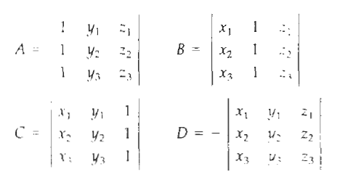
3-D Object Representation
Spatial Orientation of Surface
  Orientation of surface normal
  How to find surface normal if surface vertices (x₁,y₁,z₁), (x₂,y₂,z₂) and (x₃,y₃,z₃) are given ?
    Plane equation:
    Put the vertex coordinates to get
    One of the surface normals is: N = (A,B,C)
      (Note: Remember plane equation of form lx + my +nz = p
      i.e. N = (l,m,n) )
N = (A,B,C)
y
x
z
Prepared By: Dipesh Gautam

Slide 7

3-D Object Representation
Two sides of a surface
  For right handed cartesian system (i.e if vertices are taken in C-Clockwise order to evaluate A,B,C and D then)
y
x
z
Prepared By: Dipesh Gautam

Slide 8
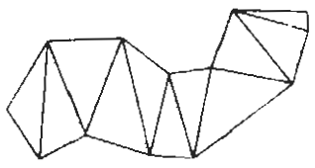
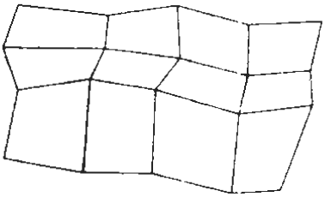
3-D Object Representation
Polygon Meshes:- object represented as:
  Triangle Strip
    Given n vertices co-ordinates, n-2 trangles are tiled to produce strip
  Quadrilateral Mesh
    Given n by m array of vertices co-ordinates, (n-1) by (m-1) quadrilaterals produce mesh
Prepared By: Dipesh Gautam

Slide 9
3-D Viewing
Prepared By: Dipesh Gautam

Slide 10
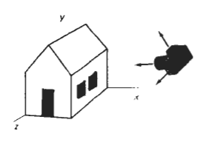
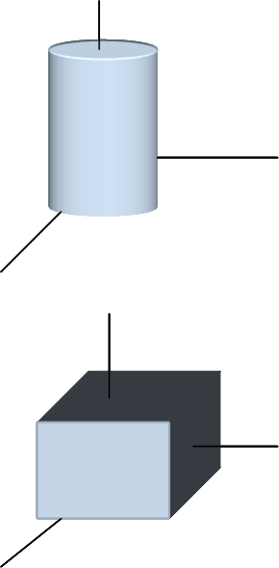
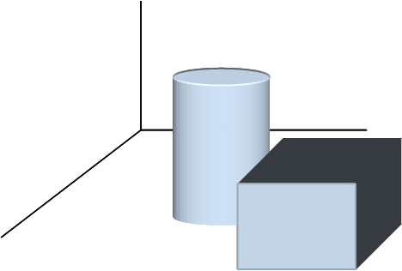
3-D Viewing Pipeline
Analogous to 2-D scene generation
3-D scene generation process analogous to taking photographs with camera
  More flexible method than camera analogy in graphics to generate 3-D scene
MC
WC
MC
Modeling Transformations
WC
Viewing Transformation
VC
Projection Transformation
PC
Workstation Transformation
DC
Prepared By: Dipesh Gautam

Slide 11
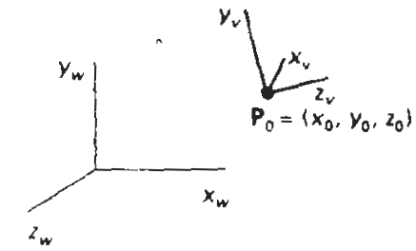
Viewing Coordinates
Specifying Viewing Plane similar to camera orientation
Steps:
  Setup viewing Coordinate Reference → how?
  Setup a view plane (projection plane) perpendicular to a viewing z_{v} axis
    Note: plane could be assumed to be similar to camera film
  Transform world co-ordinate scene to viewing coordinate scene
Viewing co-ordinates are projected unto the view plane
Prepared By: Dipesh Gautam

Slide 12
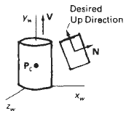
Setting Viewing Coordinates Reference
y_{w}
Pick a point in world coordinate as view reference point (origin of viewing coordinate system)
  view reference point often chosen closed to or on the surface of some object or at center of a group of objects.
  If it is near to object→ we aim camera to that object
  If it is some distance away from scene→ camera position
Specify view plane orientation with Normal vector N i.e. z_{v} axis direction. How?
  Chose a point in world coordinate
  Vector from world origin to that point or vector from that point to view reference point is direction of Normal Vector N
Specify view-up vector V to establish positive direction for y_{v} axis
  Specifying V that is perpendicular to N is difficult so V is specified in any convenient direction and establish y_{v} direction by projecting N to View plane
  In some packages V is specified as the twist angle θ_{t} about the z_{v} axis and adjusted by projecting to view plane. The projection specifies the desired direction of y_{v} axis.
  In some packages view reference point P₀ is at the center of the object, V is specified by world vector (0,1,0) and this vector is projected to the plane perpendicular to N to establish y_{v} axis as shown in figure
Establish third vector U perpendicular to both the vectors y_{v} and z_{v} to specify vector x_{v}
N
P₀
z_{v}
P
x_{w}
z_{v}
z_{w}
y_{w}
P₀
P₀
P
N
x_{w}
z_{w}
V
N
y_{w}
θ_{t}
z_{v}
y_{v}
P₀
Adjusted V
x_{w}
z_{w}
Prepared By: Dipesh Gautam

Slide 13
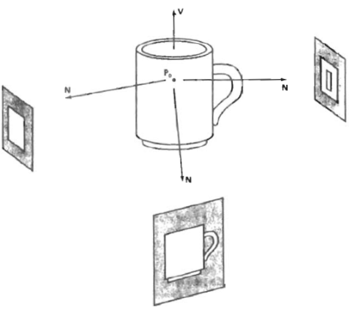
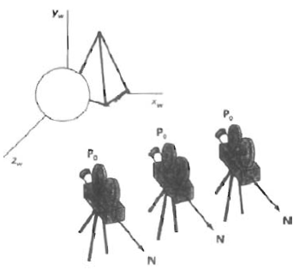
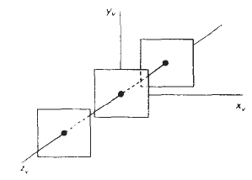
Setting Viewing Coordinates Reference (contd…)
Normalized viewing reference axis
  Specified by unit vectors u, v and n (uvn system) along viewing axes
View plane position
  Specified by view-plane-distance from viewing origin
  View plane is always parallel to x_{v}y_{v} plane
  Series of view is obtained by changing direction of N and keeping view reference point fixed. (How to obtain view along the line of v?)
  To simulate camera motion through a scene keep the direction of N fixed and change the view reference point
y_{v}
v
u
x_{v}
n
z_{v}
Prepared By: Dipesh Gautam

Slide 14
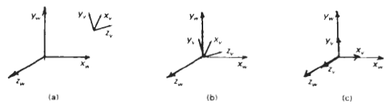

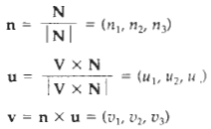

Transformation From World To Viewing Coordinates
Translate the view reference point to world origin
Rotate the view reference axis x_{v}, y_{v}, z_{v} to align with world axes x_{w}, y_{w}, z_{w} respectively
Thus the rotation matrix aligns vector u to x-axis
Similarly it alligns vectors v and n to y and z axis of world
Thus the rotation matrix is the desired matrix to align view reference frame to world coordinate frame
u₁ 1
u₂ ₌ 0
u₃ 0
1 1
R.
Prepared By: Dipesh Gautam

Slide 15
Projections
p₂
View Plane
Converts 3-D viewing co-ordinates to 2-D projection co-ordinates
  Two types of projection
    Parallel Projection
      Coordinate positions are transformed to view plane along parallel lines (projection lines)
      Orthographic and Oblique Projection
    Perspective Projection
      Coordinate positions are transformed to view plane along lines (projection lines) that converges to a point called projection reference point (center of projection)
      Equal sized object appears in different size according as distance from view plane
  Intersection of projection lines and view plane gives the projected view of the object
p₁
P₂’
P₁’
View Plane
P₂
P₁
P₂’
P₁’
Projection
Reference Point
View Plane
Projection
Reference Point
Prepared By: Dipesh Gautam

Slide 16
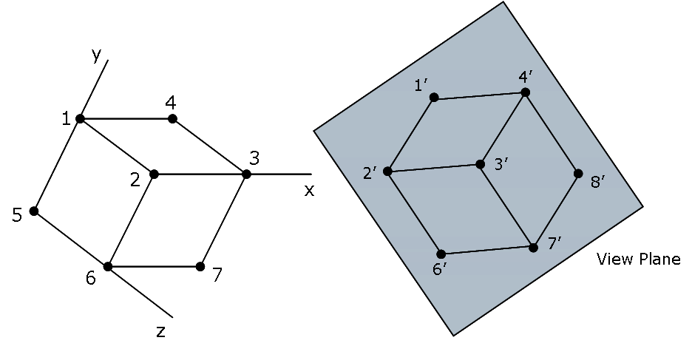
Parallel Projection
Orthographic projection:
  Projection lines are perpendicular to view plane
  Used to produce Front, Side and Top view of an object
  Axonometric Orthographic Projection:
    To display more than one face
    Isometric Projection is commonly used orthographic projection
      Generated by aligning the projection plane so that it intersect each coordinate axis in which object is defined at same distance from origin
Oblique projection: Projection lines are not perpendicular to view plane
Orthographic Projection
Oblique Projection
y_{v}
(x,y,z)
(x,y)
x_{v}
z_{v}
Prepared By: Dipesh Gautam

Slide 17
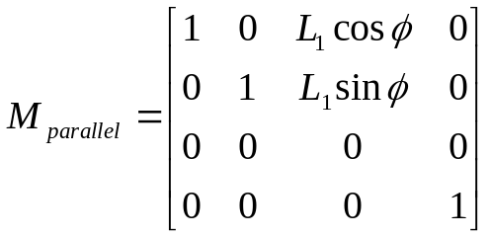
Oblique Projection
Oblique projection vectors are specified by two angles α and Ø
(x,y) are also the orthographic co-ordinates on view plane
Projection Matrix Calculation
    x_{p} = x + L.cosØ
    y_{p} = y + L.sinØ
    tanα = z/L
    L = z/tanα = z.L₁ where, L₁ = 1/tanα
    x_{p} = x + z(L₁cosØ)
    y_{p} = y + z(L₁sinØ)
Final projection matrix will be
y_{v}
(x_{p},y_{p})
α
L
(x,y,z)
  Coordinates (x,y,z) are viewing coordinates
Ø
x_{v}
(x,y)
View
Plane
Orthographic projection: When L₁ = 0
    xp = x
    y_{p} = y
Cavalier projection: when tanα = 1 (i.e α = 45⁰)
Ø = 30⁰ or 45⁰
Cabinet Projection: when tanα = 2 (i.e α = 63.4⁰)
Ø = 30⁰ or 45⁰
z_{v}
Prepared By: Dipesh Gautam

Slide 18
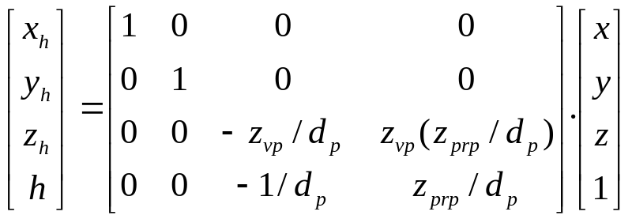
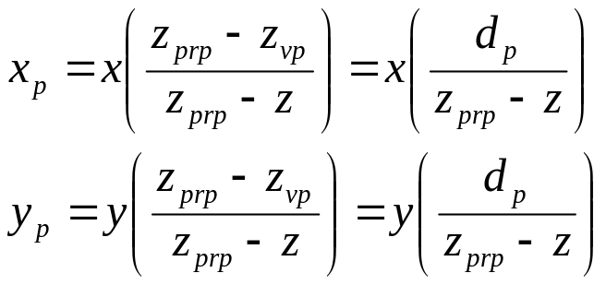
Perspective Projection
Projection vectors meet at projection reference point z_{prp} along the z_{v} axis
    x’ = x – xu
    y’ = y – yu
    z’ = z – (z-z_{prp})u
On view plane
    z’ = z_{vp}; therefore
    u = (z_{vp} - z)/(z_{prp} – z)
thus projection transformation equations are
Projection Equation in homogeneous coordinates
Where, h = (z_{prp} –z)/d_{p}
and x_{p}= x_{h}/h, y_{p} = y_{h}/h
P = (x,y,z)
(x_{p},y_{p},z_{vp})
Special cases
uv plane as view plane (i.e z_{vp} = 0)
Viewing coordinate origin as projection reference point (i.e z_{prp} = 0)
z_{v}
z_{vp}
z_{prp}
View
Plane
Prepared By: Dipesh Gautam

Slide 19
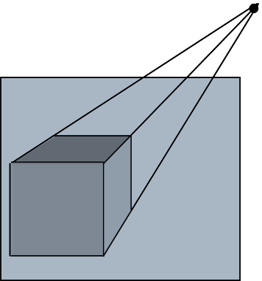
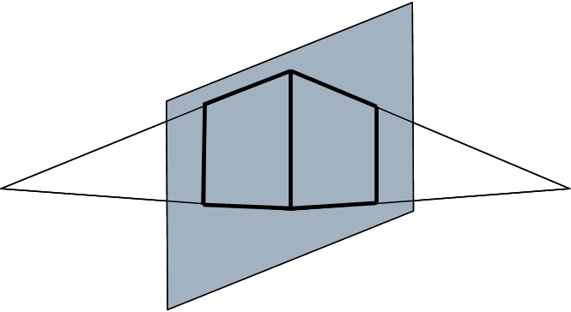
Perspective projection
y
Vanishing Point: a set of parallel lines that are not parallel to view plane are projected as converging lines that appear to converge at a point called vanishing point
a set of parallel lines that are parallel to view plane are projected as parallel lines
More than one set of parallel lines form more than one vanishing points in the scene
Principal Vanishing point: Vanishing point for a set of parallel lines parallel to one of the principal axis of object
We can control the number of principal vanishing point to one, two or three with the orientation of projection plane and classify as one, two or three point perspective projection
x
z
Vanishing
Point
X-axis
vanishing
Point
z-axis
vanishing
Point
Prepared By: Dipesh Gautam

Slide 20
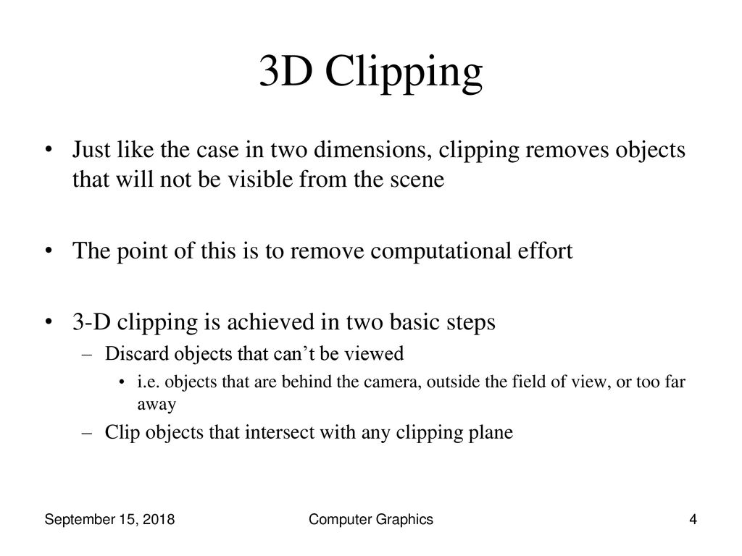
Prepared By: Dipesh Gautam

Slide 21
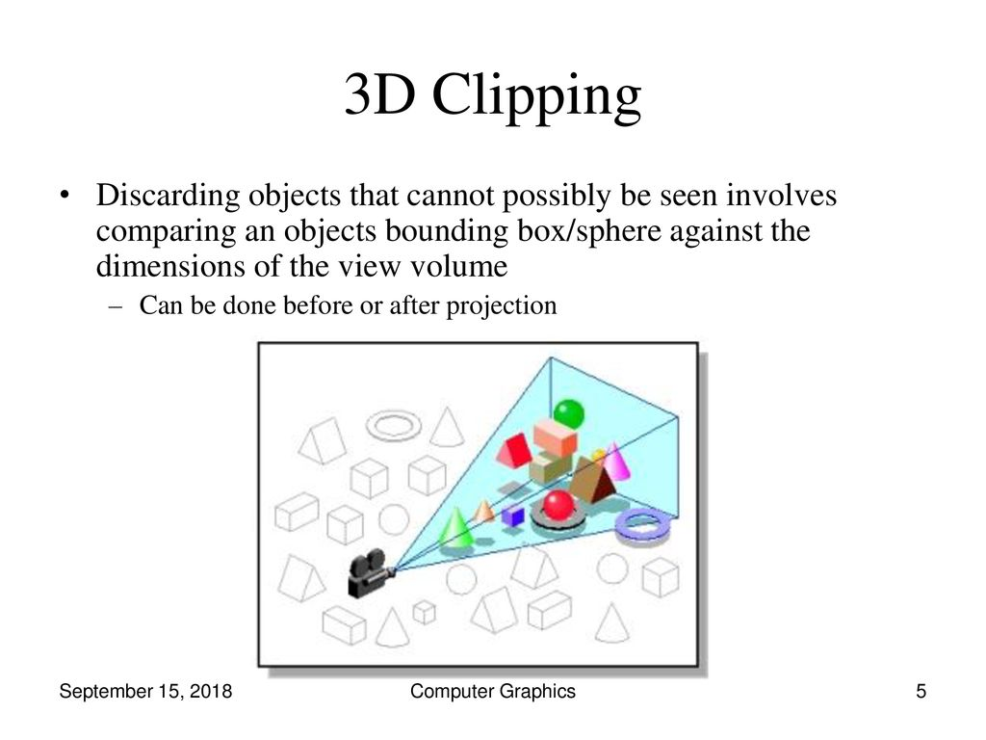
Prepared By: Dipesh Gautam

Slide 22
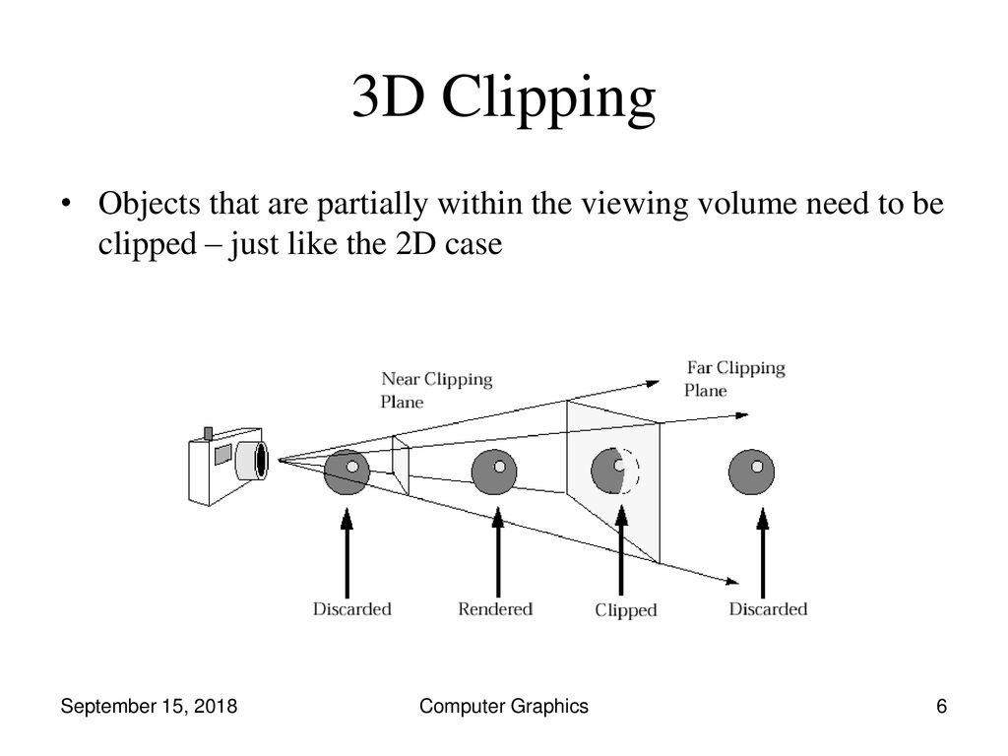
Prepared By: Dipesh Gautam

